Slide 1
Technical Report
Course 4, Task 3

Slide 2
Table of Contents
Project Scope
Technical Challenges
Analytics Process (step by step)
Recommendations

Slide 3
Project Scope
IOT Analytics wants to develop a system that predicts the general location of a person based on their “WiFi fingerprint”.
Key questions/ideas about this project:
  Besides navigation-based applications, could this technology be commercialized in other ways?
  Are there logistical challenges with installing WiFi hotspots indoors?
  Are there potential ethical (i.e. security) concerns related to the use of this technology?

Slide 4
Data Summary
The dataset for this project was sourced from three buildings at a university in Spain.
The data was created in 2013.
20 participants collected the data.
The dataset has 12,048 rows and 529 columns.
Further information can be found here.

Slide 5
Data Management
No personally identifiable data was collected or stored.
Data will be deleted after one month.

Slide 6
Technical Challenges
The primary challenge of this project was working with such a large dataset.
Given its size, applying predictive models on this dataset was computationally intensive.
  Models took ~10 to ~30 minutes to be constructed
  ~90 to ~270 minutes worth of model construction
Preparing the dataset for analysis required dimensionality reduction techniques.

Slide 7
Technical Challenges
Selecting an appropriate dependent variable to predict model efficacy
  Need to combine key location-related variables into a single variable
Balancing between model performance, runtime and computational resource expenditure
  Increasing model performance generally increases runtime and increases the risk that the program may crash due to memory/CPU overload

Slide 8
Data Analytics Process
Read the dataset documentation and understand the Business Problem.
  Understand the scope of the dataset and IOT Analytics’ intentions for this project.
Basic EDA.
  Visualizations of the different location attributes.
Created the dependent variable.
  Combined the relevant location attributes into single variable
Created sub data frames based on building type
  Dimensionality Reduction technique
  Three data frames representing each building type (A, B, and C)

Slide 9
Data Analytics Process
Dropped unnecessary columns
  Kept only the dependent variable and the WiFi hotspot attributes
Reduced the amount of WiFi hotspots in each sub data frame
  Dimensionality Reduction technique
  Removed WiFi hotspots that had zero variation, which meant that every WiFi hotspot, in some instance, registered a WiFi signal across different locations

Slide 10
Data Analytics Process
Created 9 predictive models
  KNN, RF, C5.0 models were tested on the three sub data frames
Logged prediction performance metrics using “Accuracy” and “Kappa” scores
  To reflect that the project scope was a Classification problem

Slide 11
Data Analytics Process
Utilized 10-fold cross validation
  Given the size of the data
  To limit the potential of over-fitting
Limited hyper-parameter tuning (such as the TuneLength parameter for C5.0 and KNN models)
  Sacrificed model performance to reduce the chance of program failure due to computationally intensive resource expenditure

Slide 12
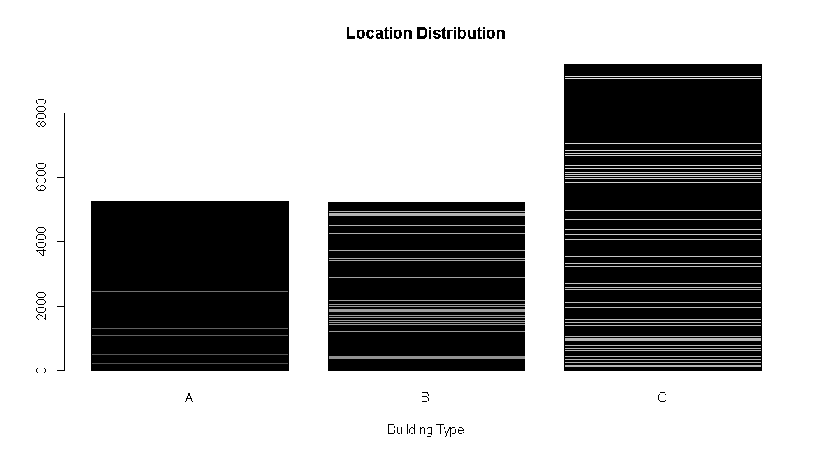
EDA Visualization

Slide 13
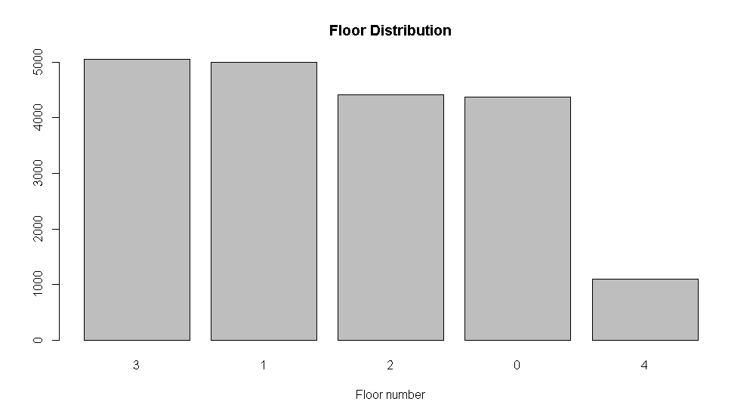
EDA Visualization

Slide 14
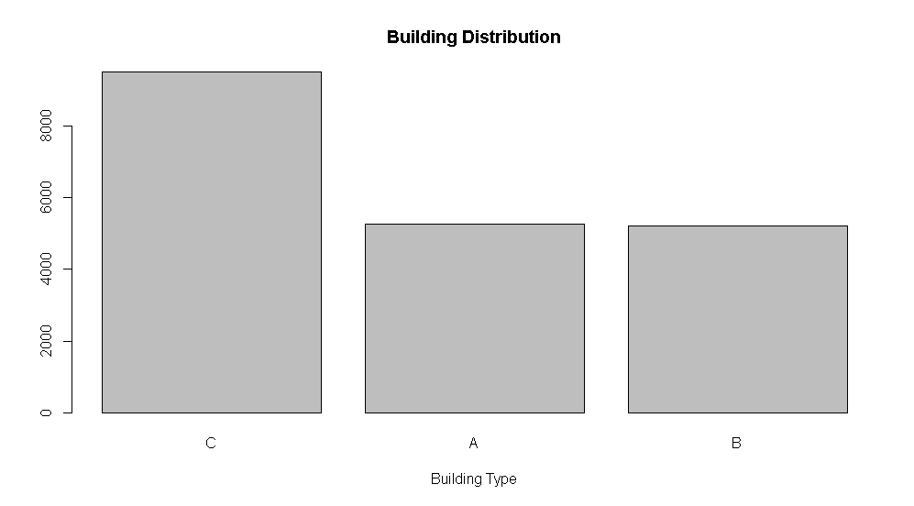
EDA Visualization

Slide 15
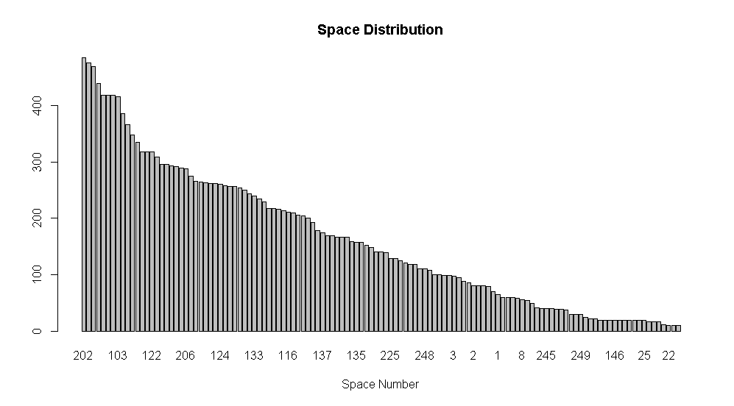
EDA Visualization

Slide 16
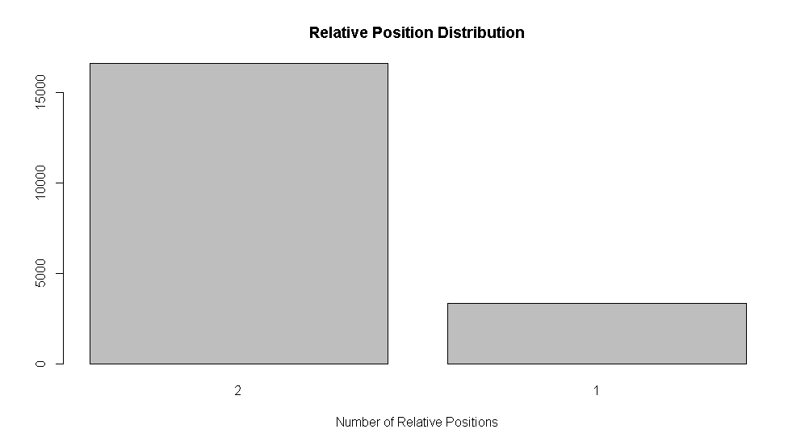
EDA Visualization

Slide 17
Model Performance
The best performing model was RF when trained with the sub dataframe B training data.
The worst performing model was KNN when trained with the sub dataframe A training data.

Slide 18
Model Selection
Given its performance metrics, the RF model using the sub dataframe B training data was chosen.
Besides its performance metrics, this training data was much smaller than the training data of the RF sub dataframe C model. This is important because this model took less time to run than the other model, which is important for enterprise production and maintenance.
High accuracy scores were prioritized because of the sensitivity of position-tracking. Inaccurate positioning systems are costly and difficult to commercialize.
Accurate positioning systems can yield better navigation services and more appropriately provide information and advertisements to users when they are in-doors.

Slide 19
Recommendations
Additional research on in-door positioning technologies and applications should be done.
Additional models and hyper-parameter tuning could have been explored had there been better computational infrastructure available. As such, it is recommended that future projects like this are done utilizing cloud-computing (AWS/Azure/Google Cloud, etc.)
Security measures should be implemented so as to avoid nefarious signal interference that may affect commercial and social utility services that may rely on this technology.

